Slide 1
THE BASIC OPERATIONS OF A COMPUTER
Regardless of type and size, all computers use the same four basic operations:
(1) Input,
(2) Processing,
(3) Storage, and
(4) Output
(5) Communications.

Slide 2
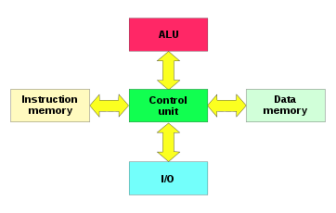
Computer Architecture/ Harvard architecture
Early computer programs were hard wired.
To reprogram a computer meant changing the hardware switches manually, that took a long time with potential errors.
Computer memory was only used for storing data.
The Harvard architecture is a computer architecture with separate storage and signal pathways for instructions and data.
Notes:
This is now called Von Neumann architecture

Slide 3
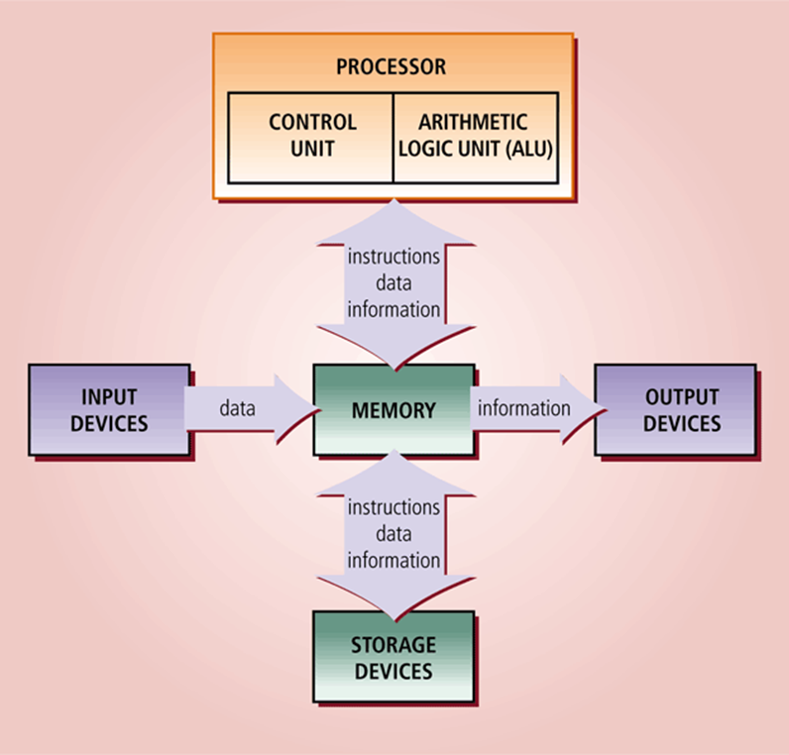
The Von Neumann Model
John von Neumann suggested that data and programs should be stored together in memory.
It contrasts with the Harvard architecture, where program instructions and data separate memory and pathways.
This “STORED-PROGRAM ” architecture is now known as Von-Neumann Architecture

Slide 4
The Von Neumann Architecture
Von Neumann microprocessor is a processor that follows this pattern:
Fetch An instruction and the necessary data are obtained from memory.
Decode The instruction and data are separated, and the components and pathways required to execute the instruction are activated.
Execute The instruction is performed, the data is manipulated, and the results are stored.

Slide 5
The Instruction Cycle of Von Neumann Architecture
Fetch
Decode
Execute

Slide 6
Parts of the Microprocessor
The simplified model consists of five parts, which are:
Arithmetic & Logic Unit (ALU) The part of the central processing unit that deals with operations such as addition, subtraction, and multiplication of integers and Boolean operations. It receives control signals from the control unit telling it to carry out these operations
Control Unit (CU) This controls the movement of instructions in and out of the processor, and also controls the operation of the ALU. It consists of a decoder, control logic circuits, and a clock to ensure everything happens at the correct time. It is also responsible for performing the instruction execution cycle.

Slide 7
Parts of the Microprocessor
Register Array This is a small amount of internal memory that is used for the quick storage and retrieval of data and instructions. All processors include some common registers used for specific functions, namely the program counter, instruction register, accumulator, memory address register and stack pointer.
System Bus This is comprised of the control bus, data bus and address bus. It is used for connections between the processor, memory and peripherals, and transferal of data between the various parts. Click the title above for more.
Notes:
. It works in conjunction with the register array for many of these, in particular, the accumulator and flag registers. The accumulator holds the results of operations, while the flag register contains a number of individual bits that are used to store information about the last operation carried out by the ALU

Slide 8
Parts of the Microprocessor
Memory The memory is not an actual part of the CPU itself, and is instead housed elsewhere on the motherboard. However, it is here that the program being executed is stored, and as such is a crucial part of the overall structure involved in program execution.

Slide 9
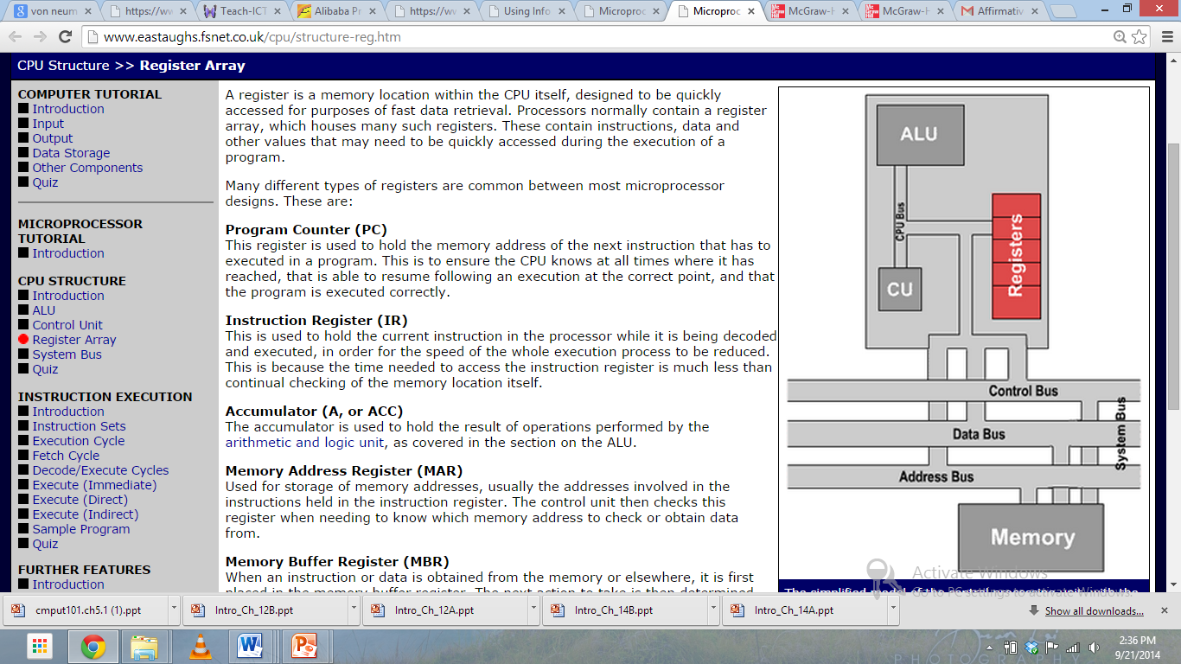
Parts of the Microprocessor

Slide 10
Operations
Addition and subtraction
Multiplication and division
Logical
Comparison
Notes:
You can look at the ALU as comprising many subcomponents for each specific task that it is required to perform. Some of these tasks and their appropriate subcomponents are:
Addition and subtraction These two tasks are performed by constructs of logic gates, such as half adders and full adders. While they may be termed 'adders', with the aid of they can also perform subtraction via use of inverters and 'two's complement' arithmetic.
The topic of logic gates is too expansive and detailed to be covered in full here. Many resources exist on the internet and elsewhere relating to this topic, however, so it is recommended that you read further into the areas outlined above to aid with your learning.
Multiplication and division In most modern processors, the multiplication and division of integer values is handled by specific floating-point hardware within the CPU. Earlier processors used either additional chips known as maths co-processors, or used a completely different method to perform the task.
Logical tests Further logic gates are used within the ALU to perform a number of different logical tests, including seeing if an operation produces a result of zero. Most of these logical tests are used to then change the values stored in the flag register, so that they may be checked later by seperate operations or instructions. Others produce a result which is then stored, and used later in further processing.
Comparison Comparison operations compare values in order to determine such things as whether one number is greater than, less than or equal to another. These operations can be performed by subtraction of one of the numbers from the other, and as such can be handled by the aforementioned logic gates. However, it is not strictly necessary for the result of the calculation to be stored in this instance.. the amount by which the values differ is not required. Instead, the appropriate status flags in the flag register are set and checked to detemine the result of the operation.
Bit shifting Shifting operations move bits left or right within a word, with different operations filling the gaps created in different ways. This is accomplished via the use of a shift register, which uses pulses from the clock within the control unit to trigger a chain reaction of movement across the bits that make up the word. Again, this is a quite complicated logical procedure, and further reading may aid your understanding.
Click the next button below to move on and look at the control unit, or alternatively click on a section of the diagram above to view a different section.

Slide 11
The Control Unit
The control unit issues control signals to the other areas of the processor, instructing them on what should be performed next. The three main elements of the control unit are Decoder
This is used to decode the instructions that make up a program when they are being processed, and to determine in what actions must be taken in order to process them. These decisions are normally taken by looking at the opcode of the instruction, together with the addressing mode used. This is covered in greater detail in the instruction execution section of this tutorial.

Slide 12
The Control Unit
Timer or clock
The timer or clock ensures that all processes and instructions are carried out and completed at the right time.
Control logic circuits
The control logic circuits are used to create the control signals themselves, which are then sent around the processor. These signals inform the arithmetic and logic unit and the register array what they actions and steps they should be performing, what data they should be using to perform said actions, and what should be done with the results.

Slide 13
Registers
A register is a memory location within the CPU itself, designed to be quickly accessed for purposes of fast data retrieval.
Program Counter (PC)
Instruction Register (IR)
Accumulator(A)
Memory Address Register (MAR)
Memory Buffer Register(MBR)
Flag Registers

Slide 14
Registers
Program Counter (PC) This register is used to hold the memory address of the next instruction that has to executed in a program.
Instruction Register (IR) This is used to hold the current instruction in the processor while it is being decoded and executed
Accumulator (A, or ACC) The accumulator is used to hold the result of operations performed by the ALU.
Memory Address Register (MAR) Used for storage of memory addresses, usually the addresses involved in the instructions held in the instruction register. The control unit then checks this register when needing to know which memory address to check or obtain data from.

Slide 15
Registers
Memory Buffer Register (MBR) When an instruction or data is obtained from the memory or elsewhere, it is first placed in the memory buffer register. The next action to take is then determined and carried out, and the data is moved on to the desired location.
Flag register / status flags The flag register is specially designed to contain all the appropriate 1-bit status flags, which are changed as a result of operations involving the arithmetic and logic unit.
Other general purpose registers These registers have no specific purpose, but are generally used for the quick storage of pieces of data that are required later in the program execution. In the model used here these are assigned the names A and B, with suffixes of L and U indicating the lower and upper sections of the register respectively.

Slide 16
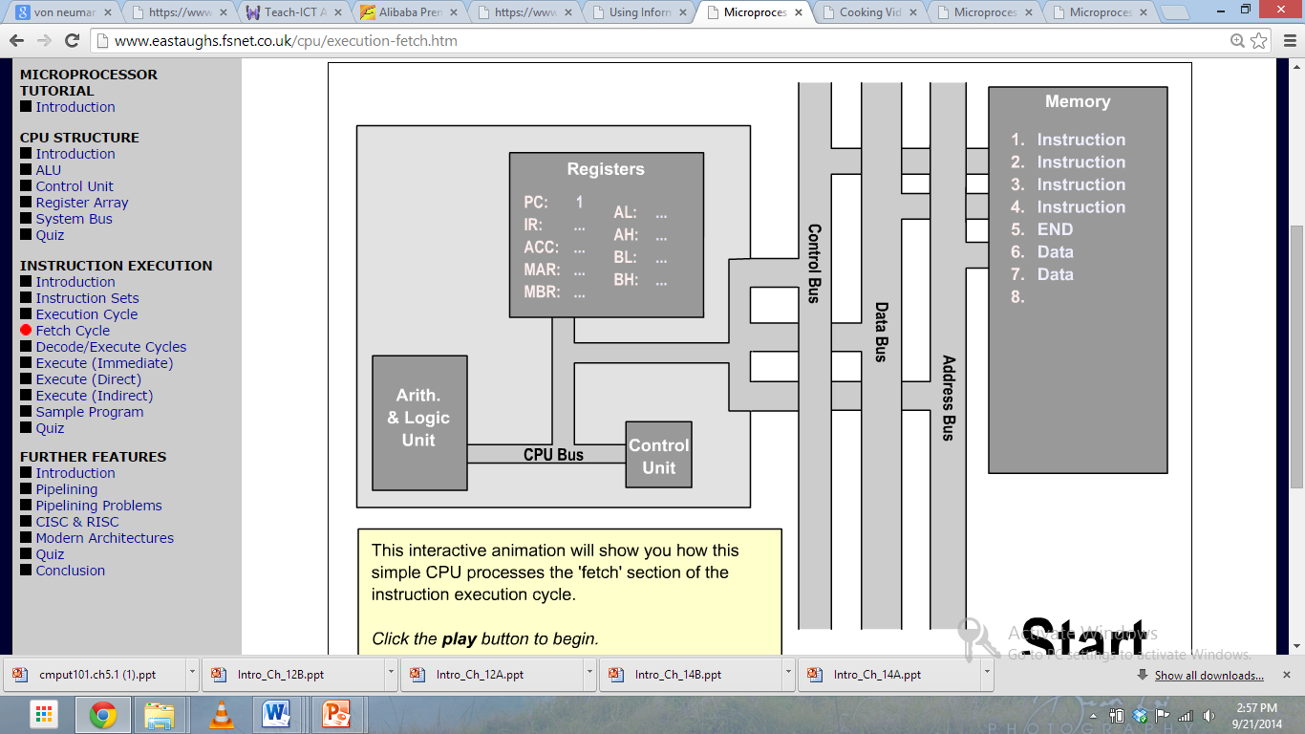
The Detailed Model of Von Neumann Architecture

Slide 17
The System Bus
The system bus is a cable which carries data communication between the major components of the computer, including the microprocessor.
The system bus consists of three different groups of wiring, called the data bus, control bus and address bus.

Slide 18
The System Bus
Control Bus The control bus carries the signals relating to the control and co-ordination of the various activities across the computer, which can be sent from the control unit within the CPU. This is a bidirectional bus.
Data Bus This is used for the exchange of data between the processor, memory and peripherals, and is bi-directional so that it allows data flow in both directions along the wires.
Address Bus The address bus contains the connections between the microprocessor and memory that carry the signals relating to the addresses which the CPU is processing at that time, such as the locations that the CPU is reading from or writing to. The maximum address capacity is equal to two to the power of the number of lines present (2^lines).

Slide 19
Note
In many older computers, the address bus was 16 bits wide (a = 16).
This meant that there were 16 wires.
Such microprocessors could address up to 2¹⁶ = 65536 memory locations.
By increasing the width of the address bus, more memory locations can be directly addressed.

Slide 20
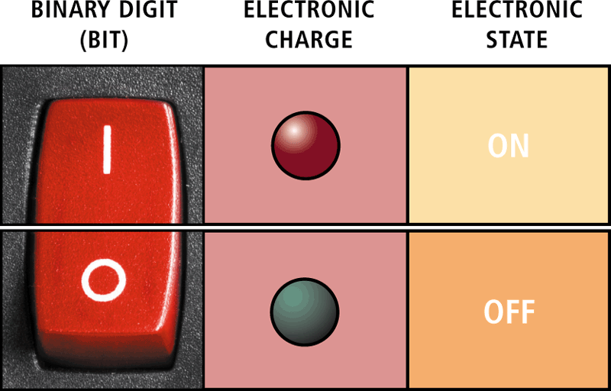
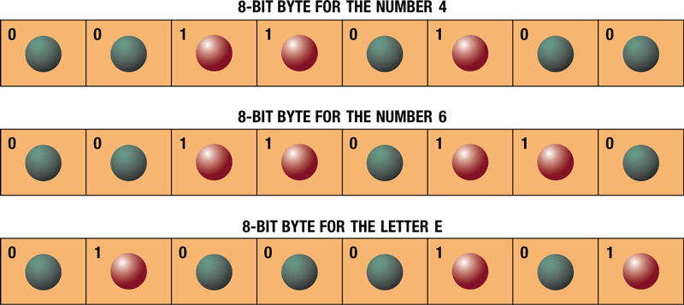
Data Representation
A computer circuit represents the 0 or the 1 electronically by the presence or absence of an electrical charge
Eight bits grouped together as a unit are called a byte. A byte represents a single character in the computer
Page 162
Figures 4-6 – 4-7

Slide 21
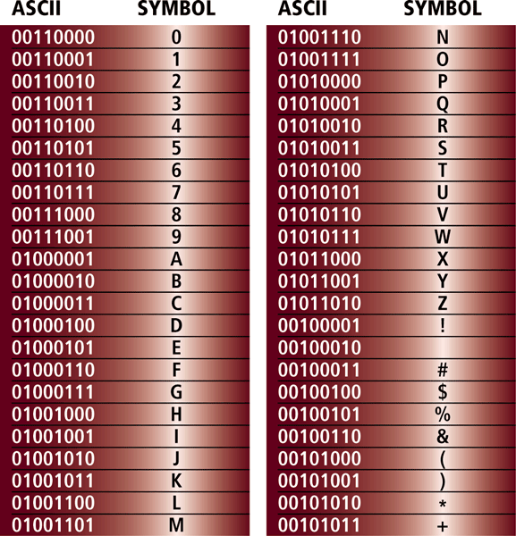
Data Representation
ASCII (American Standard Code for Information Interchange) is the most widely used coding scheme to represent data
Page 162
Figure 4-8

Slide 22
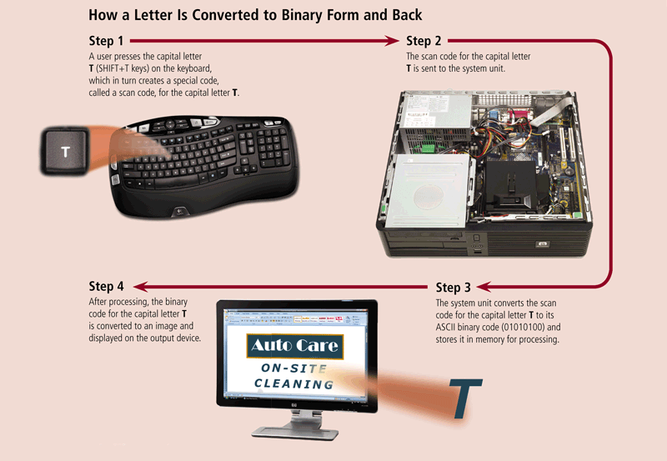
Data Representation
Page 163
Figure 4-9

Slide 23
ACTIVITY
Class Activity : Write your first name as an ASCII bit configuration

Slide 24
Why is a data bus bidirectional , and an address bus unidirectional ?
Notes:
the control bus carries commands from the CPU and returns status signals from the devices.
since data can be read /write from/to the microprocessor, hence data bus is bidirectional. if data is required read from microprocessor then it will be pointing to a memory location by the address bus, by indicating which location data its required to read. similarly to write a data to a location, again the microprocessor will be to that particular location by holding that address in address bus. hence it will be unidirectional.

